Slide 1

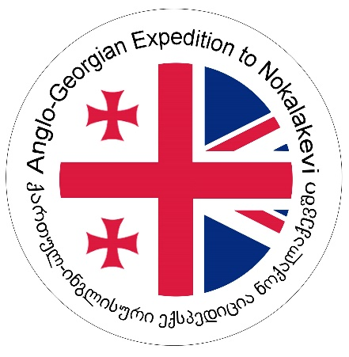

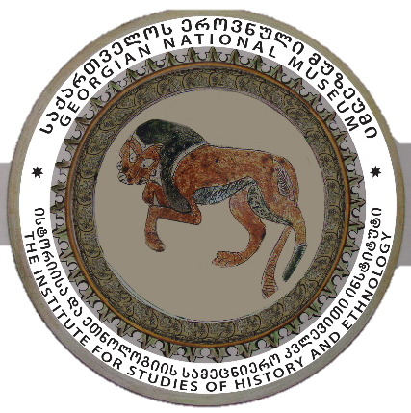
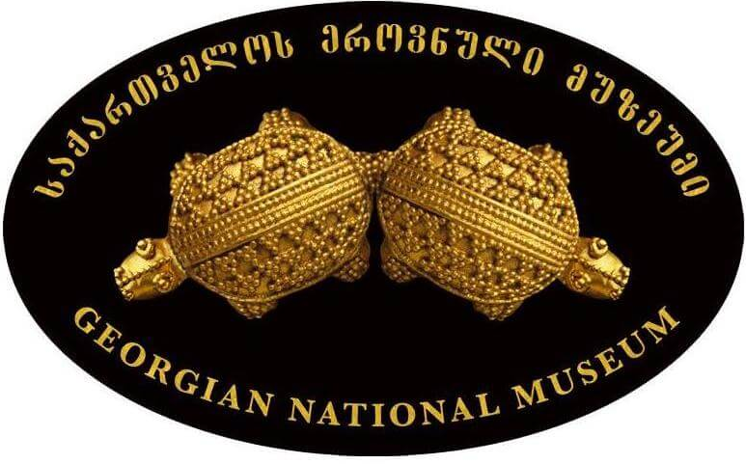

This event is jointly hosted by King's Silk Roads and the Friends of Academic Research in Georgia- FaRIG.org
This presentation was supported by Shota
Rustaveli National Science Foundation of
Georgia (SRNSFG) [grant number FR-22-117]
The Kingdom of Egrisi (Lazica), 1st-8th c. AD:
an historical and archaeological overview
Presented by: Dr. Nikoloz Murgulia
Senior Scientist, Georgian National Museum
Tbilisi-Cambridge
17.02.2026

Slide 2
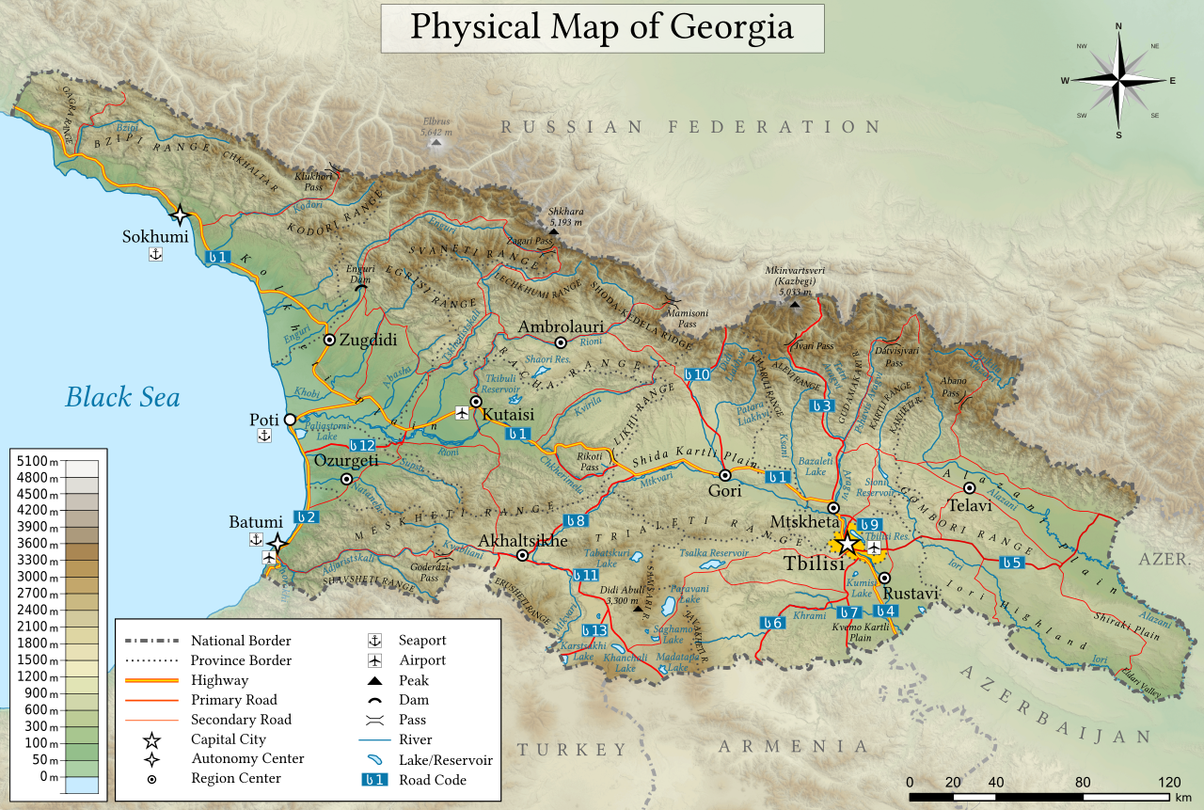
Georgia is a country in Eurasia to the east of the Black Sea, most of which is located in the South Caucasus. To the north, it is bounded by the Caucasus ridge, to the south by the Lesser Caucasus Mountains, and to the west by the eastern Black Sea coast.
Mountains are the dominant geographic feature of Georgia. The Likhi Range divides the country into eastern and western halves. At present the area of Georgia totals 69,7 sq. km.; According to ancient oriental and later antique annals, the territory was always settled by the tribes of Georgian origins.
One of the most important geographic regions of Georgia is swampy Colchis Plain, of triangular shape in close to the Black Sea littoral.

Slide 3
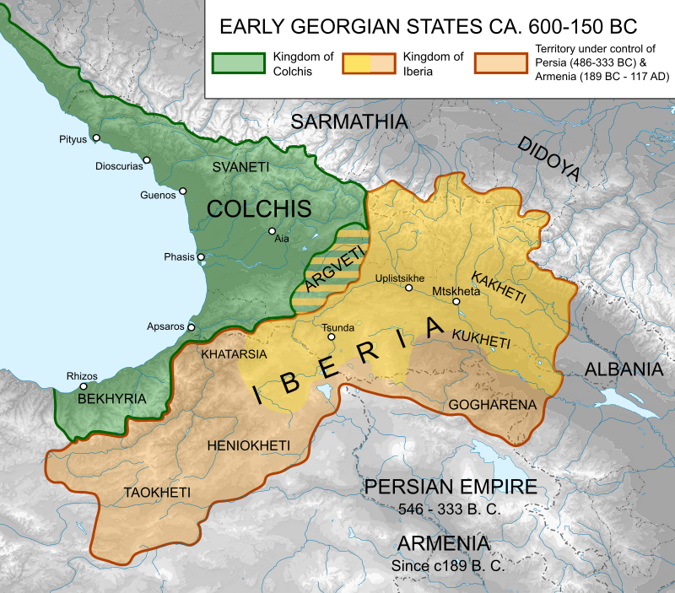
The Kingdom of Colchis (6th-4th cc BC)
Greek colonisation of the Black Sea began early in the first millennium BC, with colonies founded initially in towns on the northern coast of Asia Minor. The earliest extant Greek texts show that in the 8th century Colchis and the Caucasus had already been integrated into the world of Greek myth and imagination.
Greek colonies on the Colchian shore were only founded from the 6th century BC. Historical sources and archaeological excavation identify five colonies—Pityus, Dioscurias, Gyenos, Phasis and Pichvnari.
Greek pottery, fine wares and storage containers from this period are to be found in coastal settlements, in towns along the Rioni, and further inland.
The effects of these settlements can, however, be observed in the archaeological record—most directly on the coast, or inland at river ports. This period is a very rich for west Georgian archaeology. Sites like Vani, Pityus, Sebastopolis-Dioscorias and Pichvnari show plentiful material remains, including the stunningly wealthy burials of Vani.

Slide 4
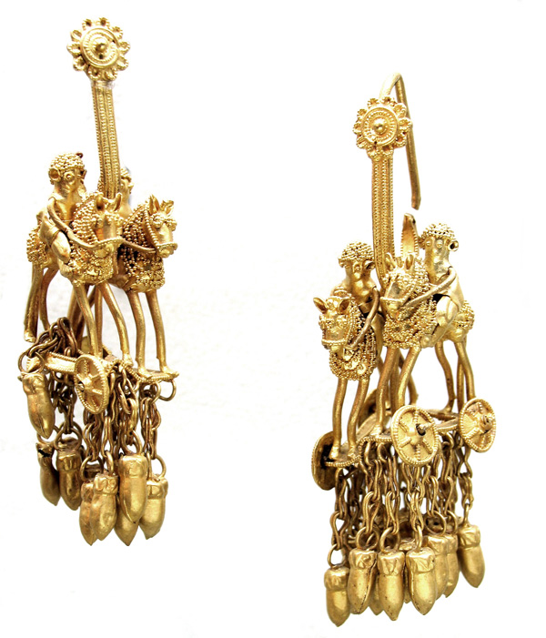
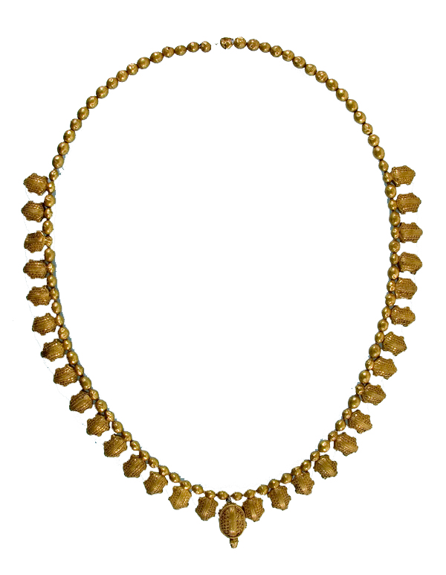
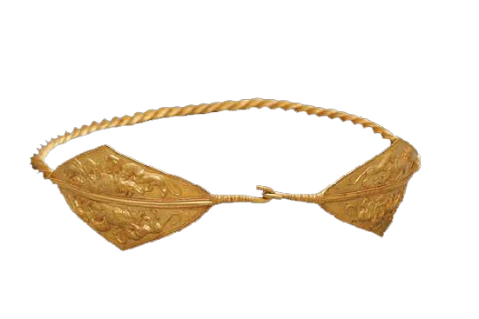
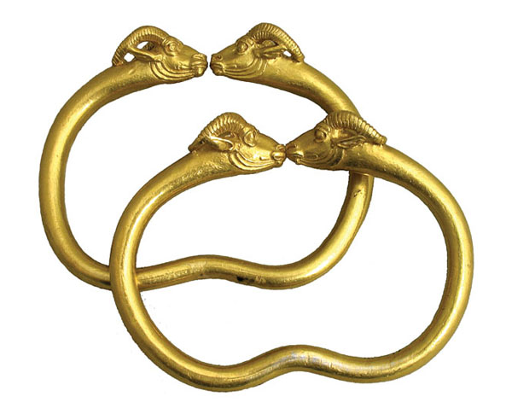
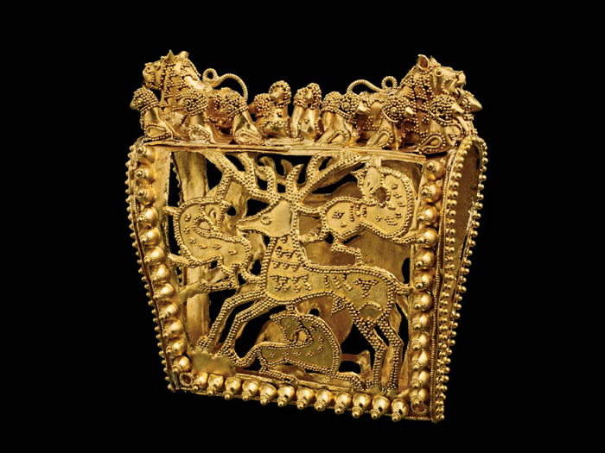
Grave goods from Vani
5th – 4th cc BC

Slide 5
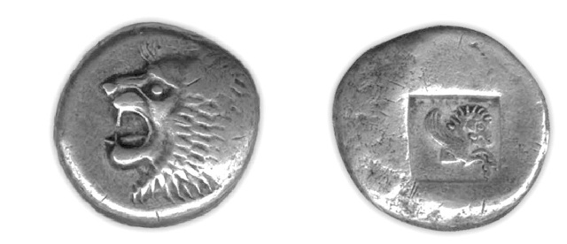
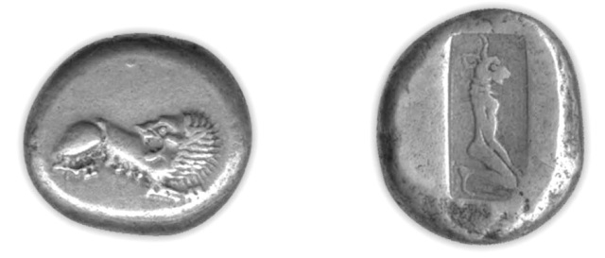
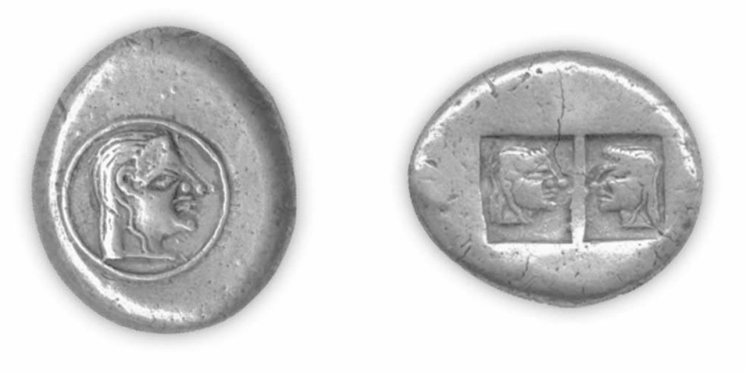
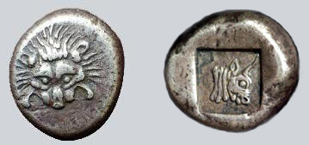
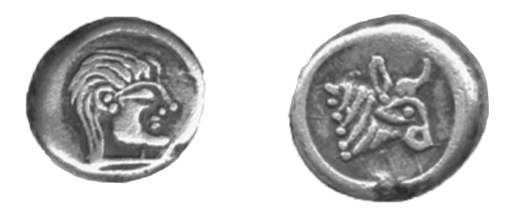
Colchian coins – 6th – 3rd cc BC

Slide 6
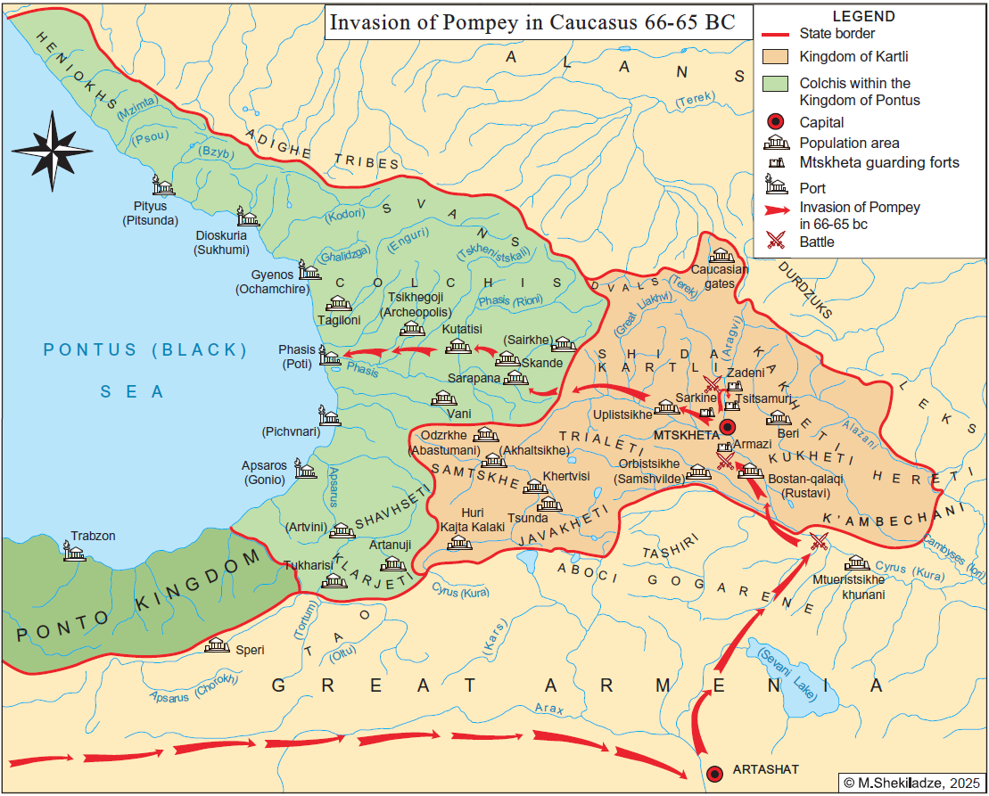
The fall of Colchis Kingdom
The kingdom of Colchis collapsed in the 1st century BC as a result of the Mithridatic wars and the campaign of Pompey the Great (106-48 BC) in the Caucasus. The former territory of Colchis was added to the province of Pontus and later (63 AD) united into the province of Galatia.
Several small kingdoms emerged in West Georgia during the 1st - 2nd centuries. Arrian of Nicomedia (The counsel of emperor Hadrian (117-138) in Cappadocia), during his trip around the east coast of the Black Sea, mentioned several tribes in the territory between Trapezunt and Sebastopolis: Colchians, Sans, Makrones, Heniochs, Dzidrits, Lazs, Apsilians, Abasgians, and Saniges. Those tribes were ruled by kings, though they were vassals to the Roman Emperor.
In the end of 3rd century Laz became the most powerful kingdom of West Georgia.

Slide 7
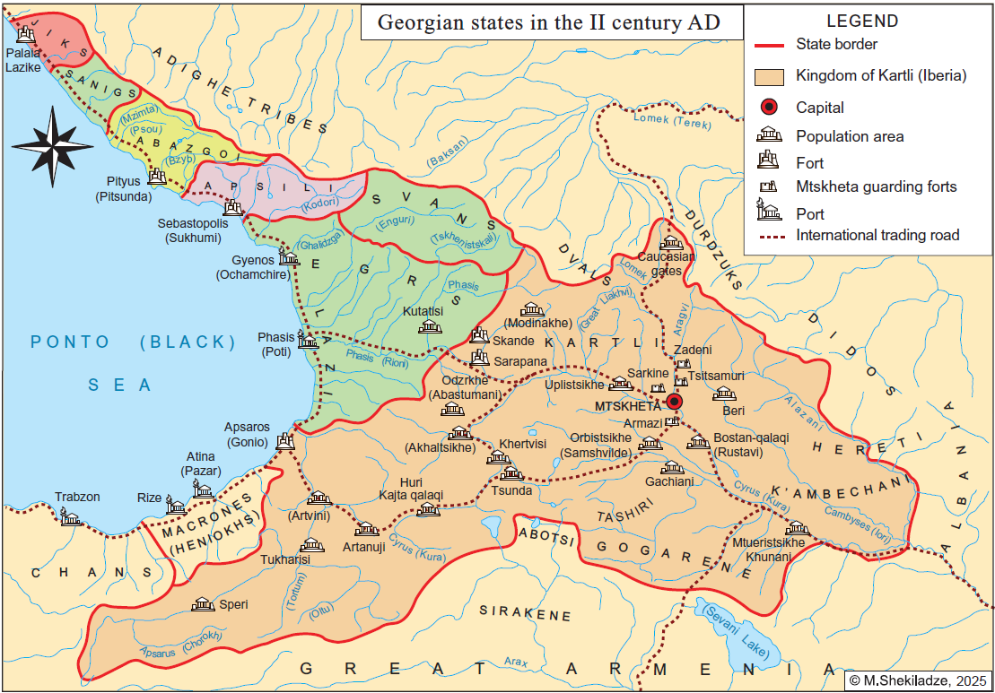
The foundation of Egrisi (Lazica) Kingdom
At the end of 3rd - beginning of 4th century, the Roman empire was weakened by the growth of foreign powers (Goth and Hun attacks on Roman territory; and the strengthening of Persia and its occupation of Iberia, Armenia and Albania) and lost control of its eastern provinces, including the West Georgian kingdoms. There were no Roman troops on the east Black Sea coast from the beginning of the 4th century, and the vassal relationship between Rome and Egrisi became very formal in character. In this period the Laz appear to have annexed the neighbouring tribes - Apsilians, Abasgians and Saniges. The Laz also annexed Svania and Racha-Lechkhumi at the end of 4th century. So, from the 3rd century, the Laz annexed all neighbouring tribes one at a time; uniting West Georgia and creating the new Kingdom of Lazica (Egrisi).

Slide 8
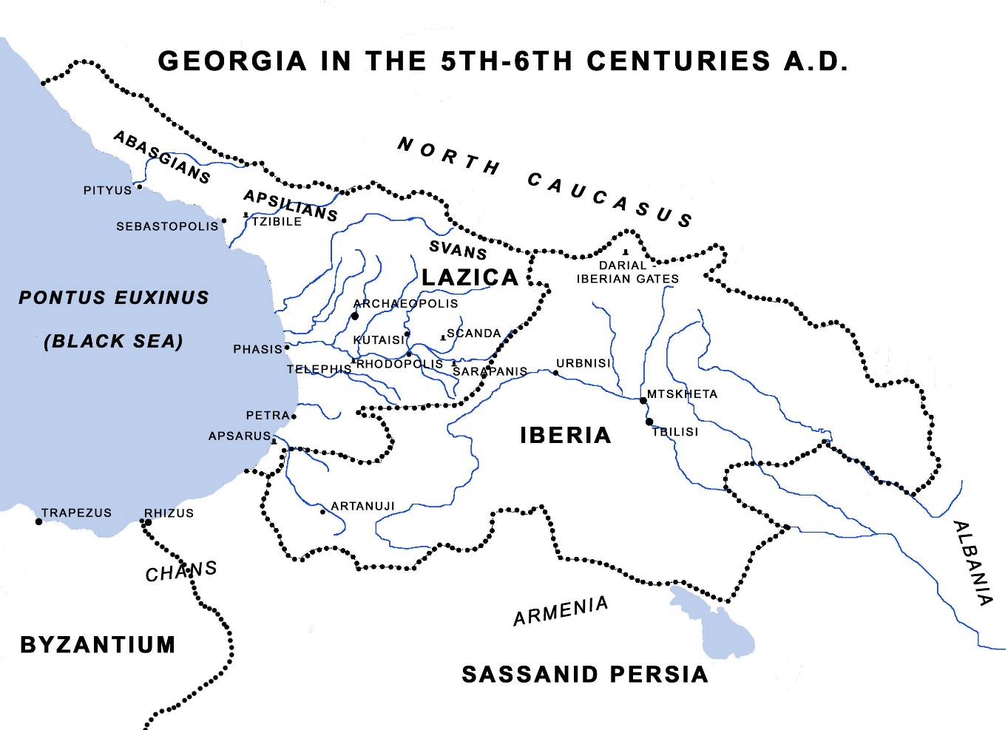
Agathias of Myrina (6th c. Greek historian) about Lazs:
The inhabitants of Lazica were called Colchians in ancient times, so that the Lazi and the Colchians are the same people. That this is the case can easily be inferred from such landmarks as the river Phasis and the Caucasus and the fact that they have inhabited these regions for a very long time.
The Lazi are a great and a proud people and they rule over other very considerable peoples. They pride themselves on their connection with the ancient name of the Colchians and have an exaggeratedly, though perhaps understandably, high opinion of themselves. I certainly know of no other subject race with such ample resources of manpower at its command or which is blessed with such a superfluity of wealth, with such an ideal geographical position, ... and with such a high standard of civilization and refinement. The ancient inhabitants of the place were indeed completely unaware of the benefits of navigation and had not even heard of ships until the arrival of the famous Argo. Nowadays they put out to sea whenever practicable and carry on a thriving commerce.
Nor are they barbarians in any other respect, long association with the Romans having led them to adopt a civilized and lawabiding style of life.

Slide 9
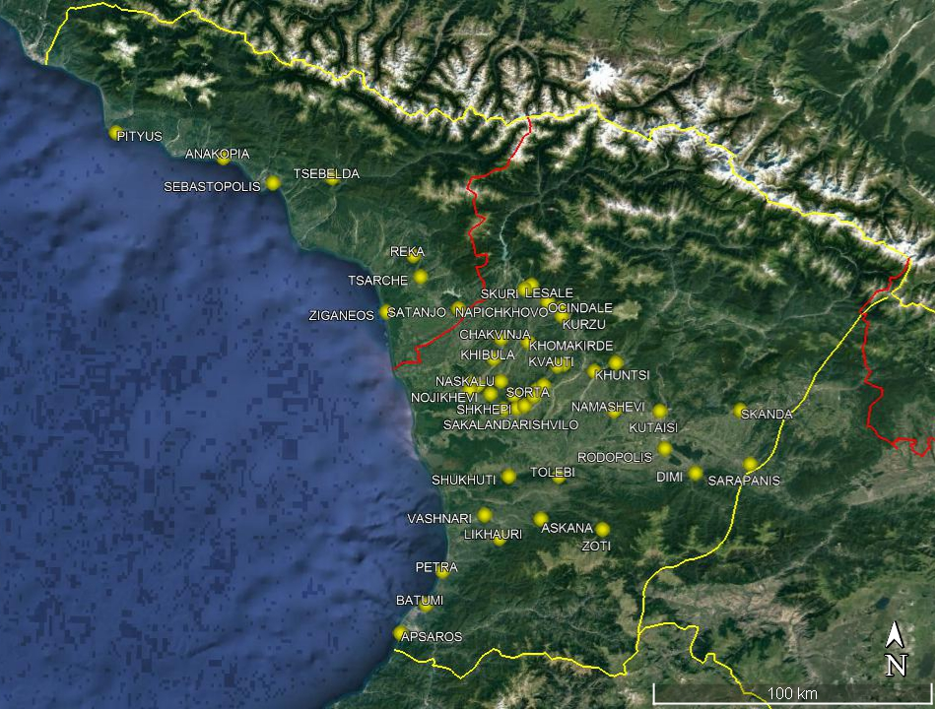
The rulers of the newly founded kingdom took responsibility for the defence of their borders. Its geopolitical location meant that Lazica faced a number of threats – from the Roman (later Byzantine) Empire in the west; Sassanid Persia from the east; and nomadic warrior tribes from the north – and consequently the rulers of the kingdom organised strong lines of fortification along their borders.
A significant number (About 60) of early medieval castles (4th-6th centuries) were discovered and studied by archaeological survey and excavation in West Georgia in the 20th-21st centuries.
Procopius of Caesarea (6th c. Greek historian) about Lazs:
The Lazi at first dwelt in the land of Colchis as subjects of the Romans, but not to the extent of paying them tribute or obeying their commands in any respect, except that, whenever their king died, the Roman emperor would send emblems of the office to him who was about to succeed to the throne.
And he, together with his subjects, guarded strictly the boundaries of the land in order that hostile Huns might not proceed from the Caucasus mountains, which adjoin their territory, through Lazica and invade the land of the Romans.
And they kept guard without receiving money or troops from the Romans and without ever joining the Roman armies…
…As regards the barbarians dwelling in the Caucasus, Lazica was nothing else than a bulwark against them.

Slide 10
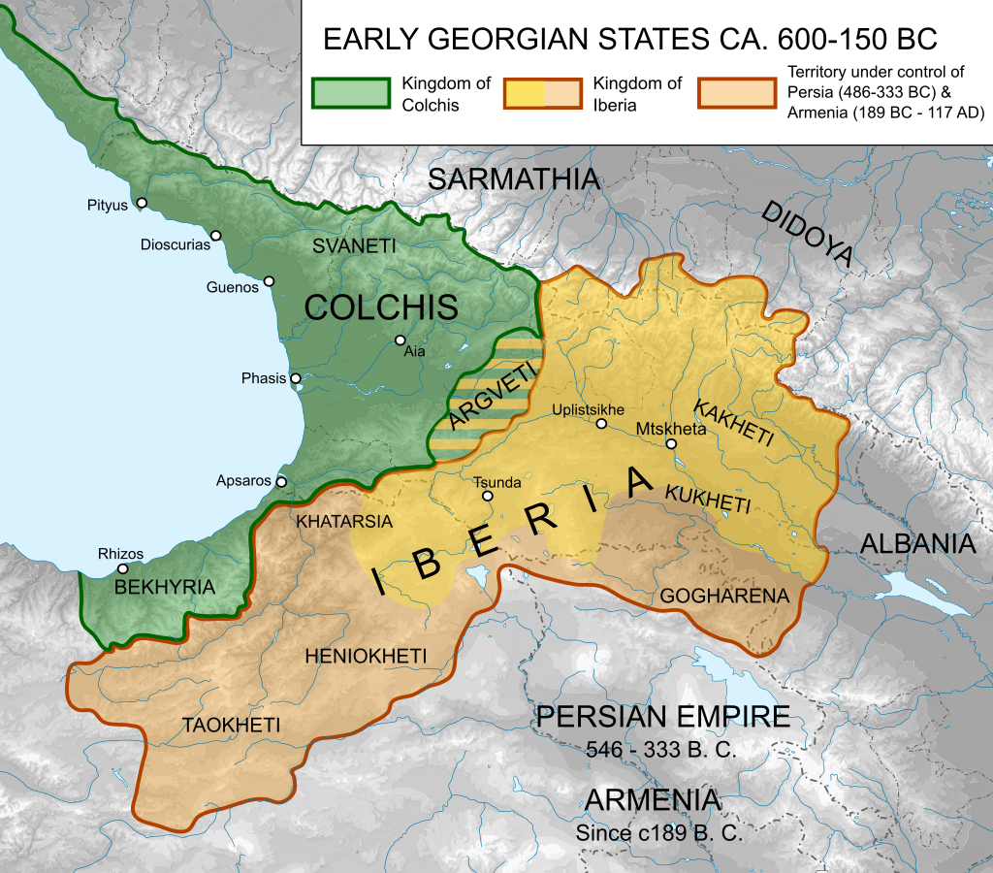
Saint Andrew the first-called
Missionary journey to West Georgia
According to the Georgian Church tradition, Christianity was introduced to West Georgia by apostles - Andrew the first-called, Simon the Zealot and Saint Matthias. This tradition is based on Byzantine written sources – Sophronius (4th-5th cc AD), Dorotheos (6th c AD) and Pseudo Epiphanous (6th-7th cc AD).
Those authors describe the places to which Saint Andrew the first called travelled, and among them they mention Sebastopolis, Aphsaros, unnamed communities along the banks of the river Phasis, Colchis and Iberia. According to one version Saint Andrew travelled in Georgia on three occasions and Simon the Zealot and Saint Matthias accompanied him on the third trip.

Slide 11
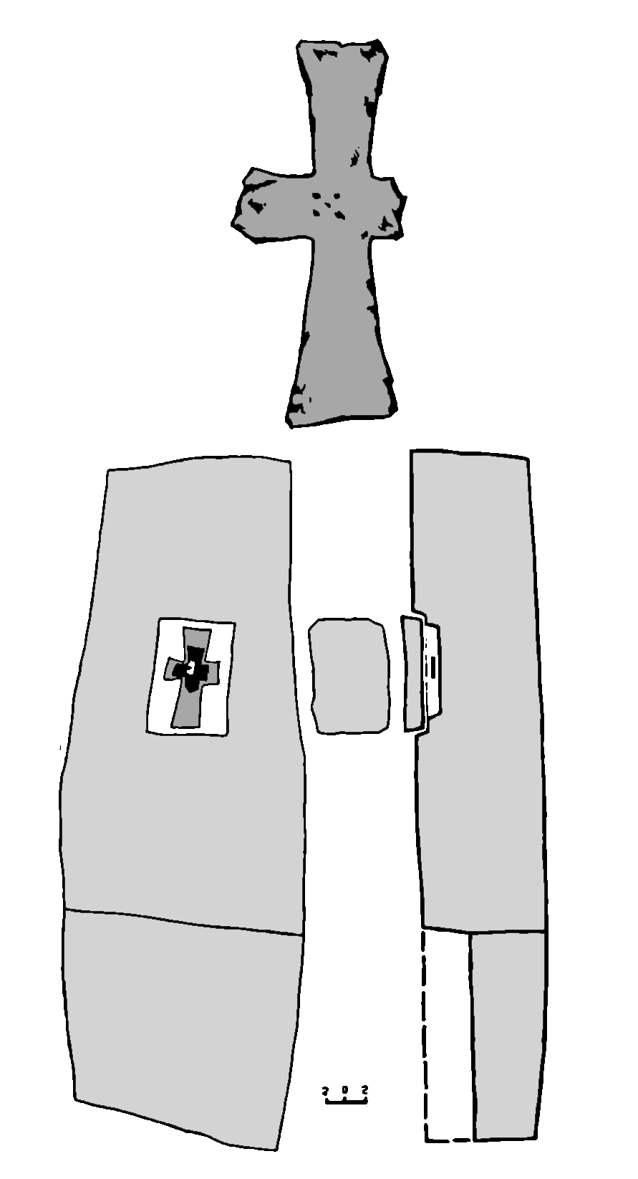
Iron cross, hid in Stone stele from Pityus, dated 3rd-4th cc AD
Unfortunately we don’t have direct archaeological signs to prove Apostles journey to Georgia, but It is interesting to note that we have archaeological evidence that shows early Christian communities living in West Georgia before the official conversion, in the 2nd-3rd centuries. Various artifacts have been discovered during archaeological excavations in historic Pityus, (Modern Bichvinta, Pitsunda – west Georgia, in the region of Apkhazia, occupied by the Russian Federation). Those artefacts include an iron cross, hidden in a Stone stele, dated 3rd c AD. In addition, some artifacts with Christian symbols (fish, peacock etc.) have been discovered during excavation at Gonio-Aphsaros and Petra-Tsikhisdziri.

Slide 12
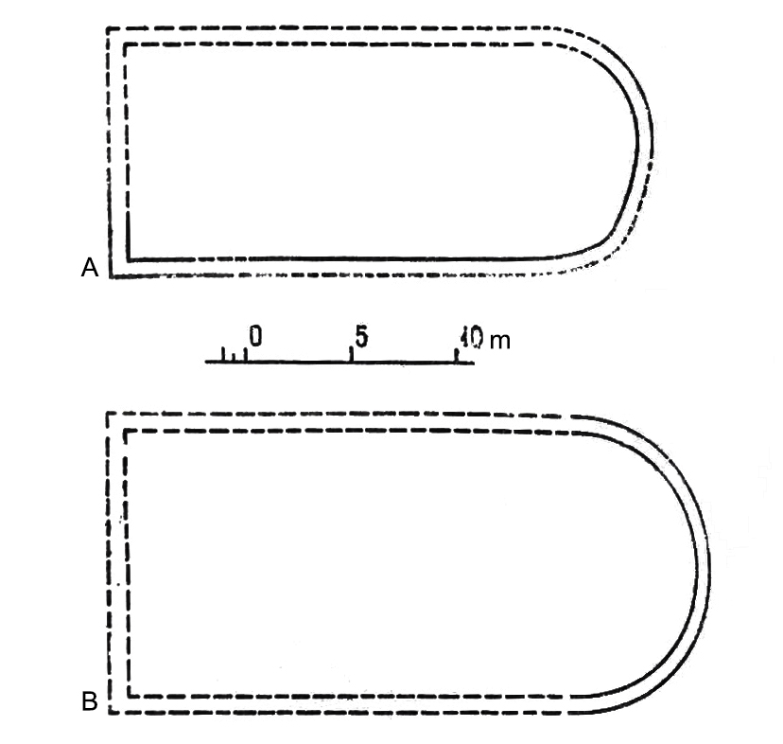
Earliest (beginning of 4th century) hall churches from Bichvinta-Pityus (A) and Nokalakevi-Archaeopolis (B)
Christianity was declared the official religion in Lazica in the first half of the 4th century. According to the 4th century bishop Gelasius of Caesarea in the period of the reign of Constantine the Great (306-337), the Lazs and Iberians were converted to Christianity. Other authors also state that Georgian tribes and states were converted in the same period. Also, it is worth mentioning that Stratophilus, bishop of Pityus, attended The First ecumenical Council of Nicaea in 325.
Ruins of the hall churches discovered in the main cities of Lazica like Pityus and Nokalakevi-Archaeopolis (The capital city of the state) are dated to the end of the 3rd - beginning of the 4th century. It is interesting that in Nokalakevi-Archaeopolis the church was built in the Royal quarter of the lower town, which means that Christianity had already been recognized as the state religion in the country.

Slide 13
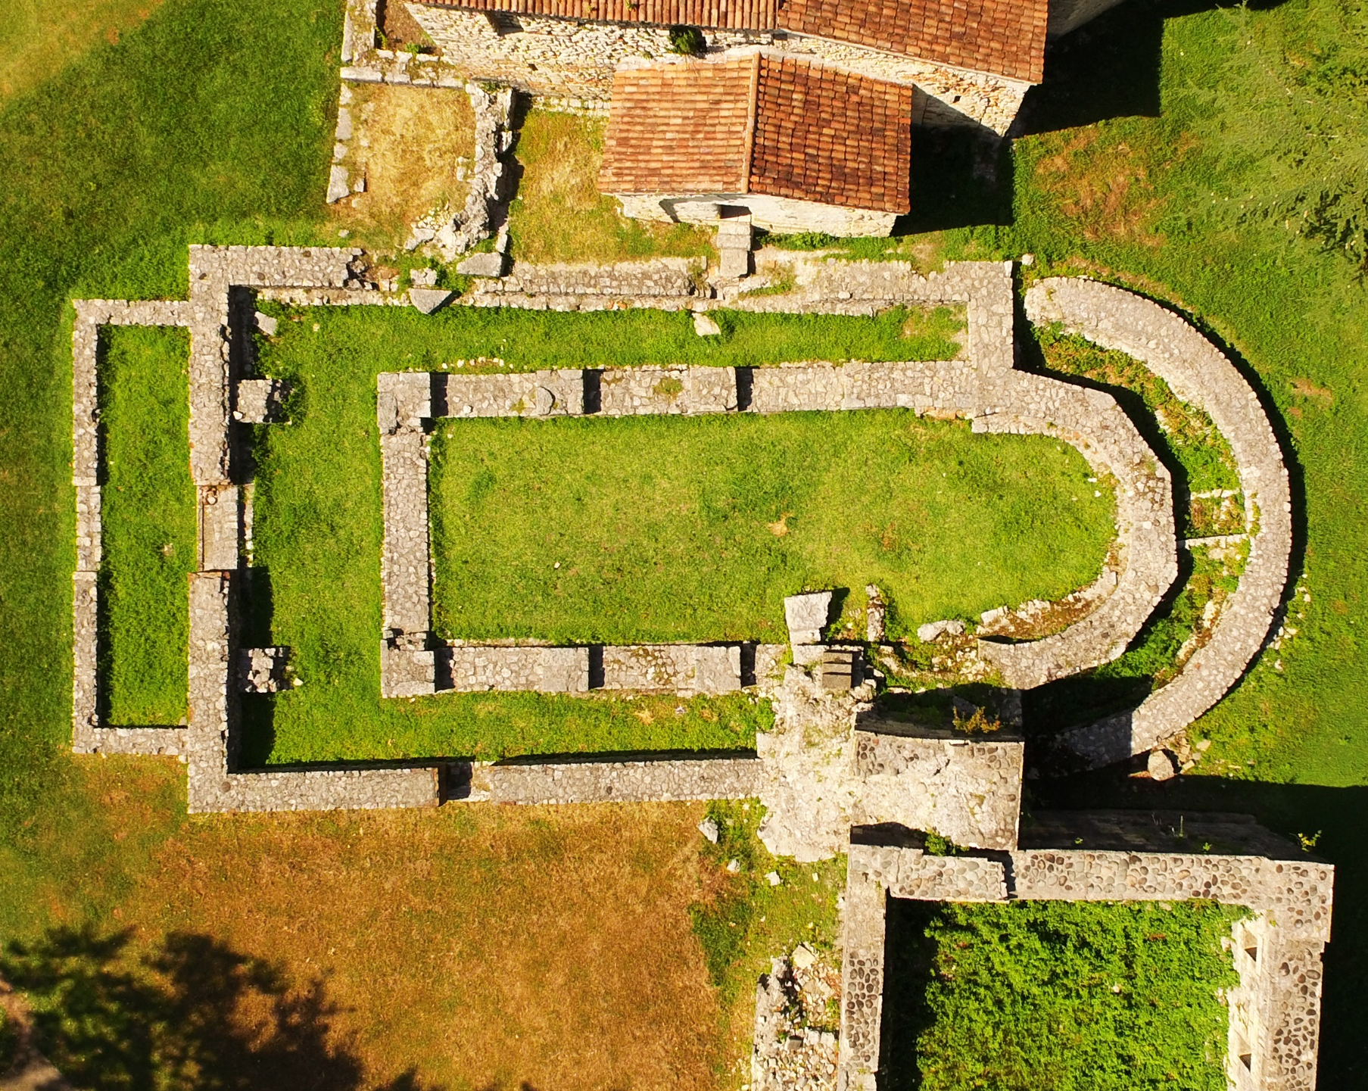
Aerial view of the lower town of Nokalakevi-Archaeopolis –
4th, 5th and 6th centuries churches in the royal quarter of the city
While Christianity was first declared the official religion in West Georgian in the first half of the 4th century, the Kings of Lazika continued to seek balance in their relationship with Byzantium and Sassanid Persia. They used religion as a political tool in their engagement with the two great empires – Rome/Byzantium (Christianity) and Sassanid Persia (Zoroastrianism).
In the beginning of the 5th century a new, three-nave basilica was built on top of the original hall church. That basilica did not survive very long either, and was destroyed by the end of the same century, and in the beginning of the 6th century the stone steps of a royal palace were built on top of the south wall of basilica.
We think this might represent a statement by the rulers, that the ruins of the church weren’t sacred to them, or something to be respected, they could just build stairs on top of it.

Slide 14
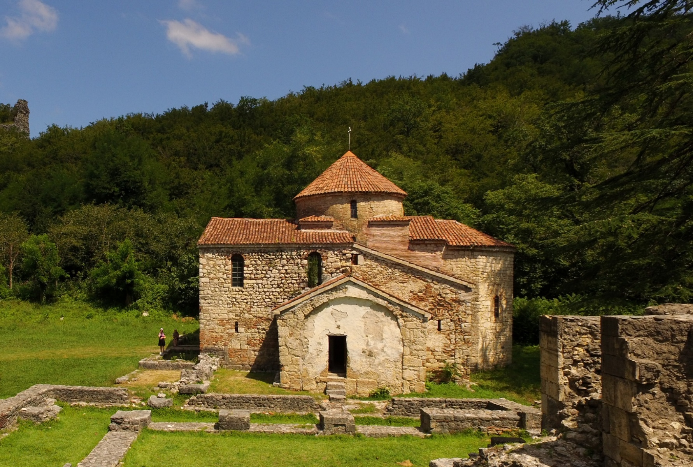
Forty Martyrs’ church. 6th century. View from south
According to written sources there are at least two instances of Laz kings choosing a Persian orientation and renouncing Christianity. Eventually, Christianity was declared the official religion in 523, when King Tsathe was baptised.
The situation seems to change radically in the 6th century AD, after King Tzathe was baptised in 523. From this date the 6th century witnessed the construction of, many churches all over the kingdom. This period of construction includes four new churches in Nokalakevi: two in the Royal Quarter, one in the Middle Town and one within the Citadel. The main church at Nokalakevi is the Forty Martyrs domed basilica

Slide 15
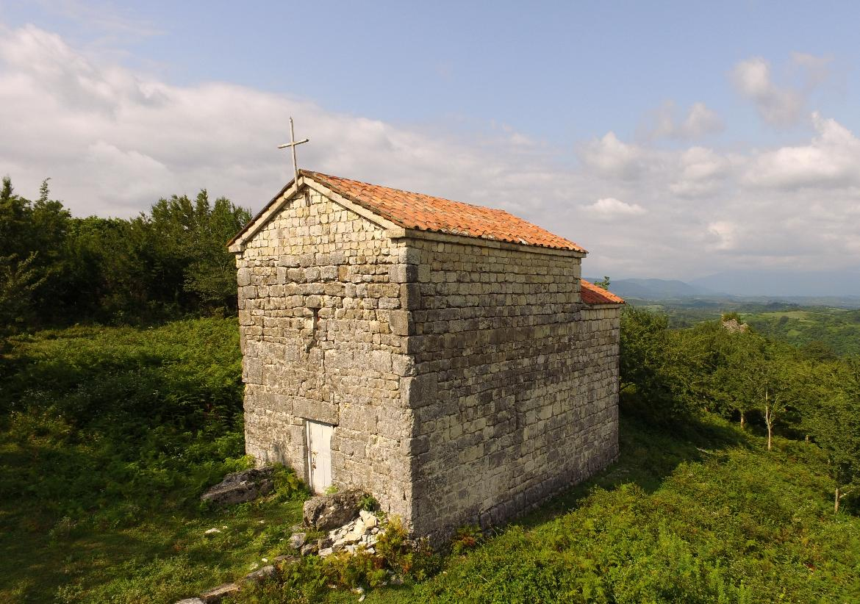
The Jege-Misaroni church from North-West
It is also worth mentioning the hall-church dedicated to Saint George within the citadel of Nokalakevi. It is hall-shaped church. Its local name is Jege-Misaron, which itself provides an interesting insight into the local response to Christianity. It is well known that Mithraism was one of the most popular religions in the Late Roman empire. Mithras was a warrior god, a protector of pure people, and in Christianity many attributes of Mithras were later assigned to Saint George. ‘Jege’ in Mengrelian means George and Misaron (Misra) might be connected to Mithras.

Slide 16
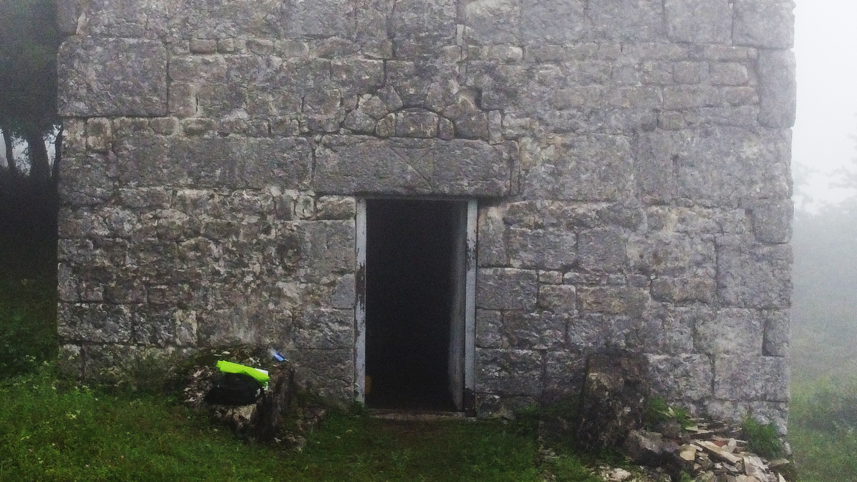
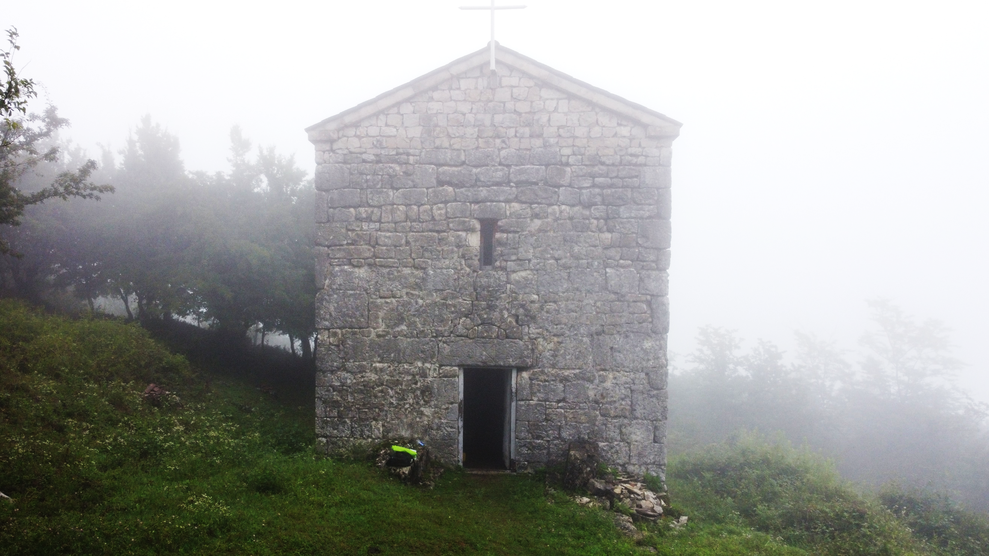
Saint Andrew cross on the architrave of the main gate of Jege-Misaroni church

Slide 17
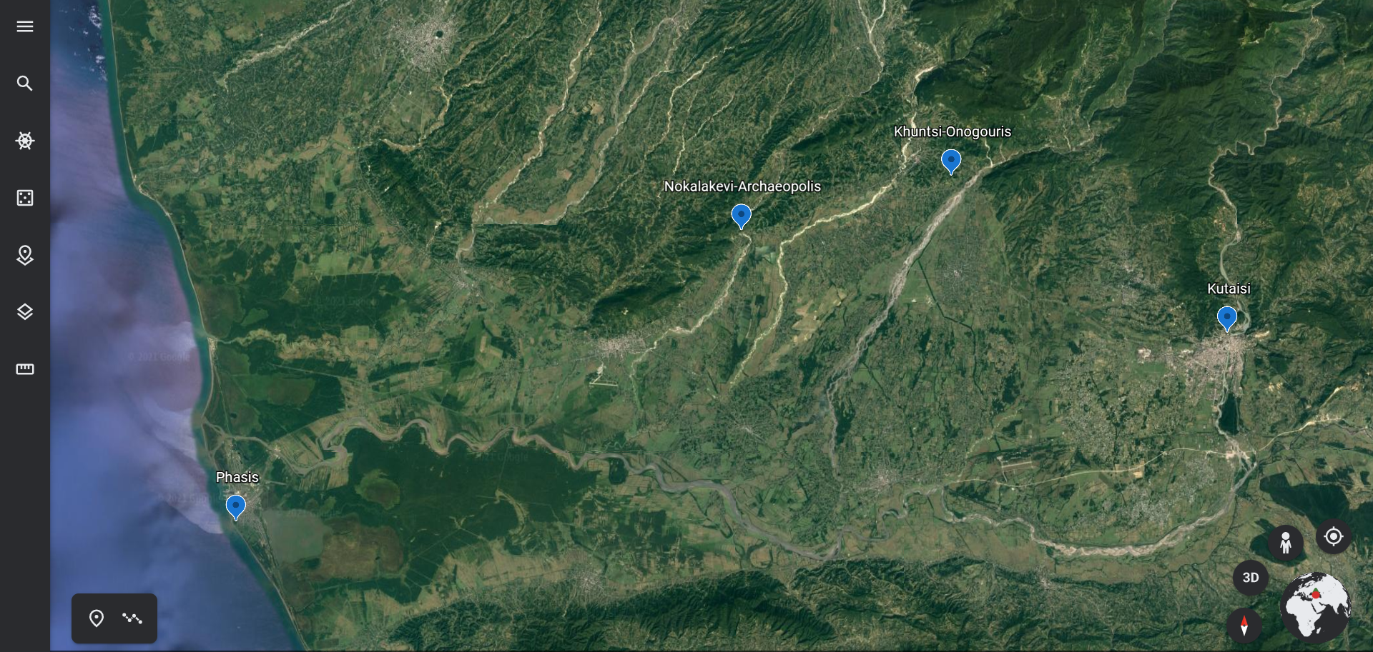
Location of Khuntsi Fortress – Onogouris (?)
when we speak about relations between Christianity and other religions, and the conflicts and assimilation that took place in West Georgia, it is necessary to include some new discoveries of the Anglo-Georgian Expedition to Nokalakevi.
In 2014 we received information regarding the ruins of a fortress 25 km east of Nokalakevi-Archaeopolis.
We visited the site and found a very interesting monument, situated perfectly to control routes and
the plain between two important Laz cities, Kutaisi-Mokhiris and Nokalakevi-Archaeopolis.

Slide 18
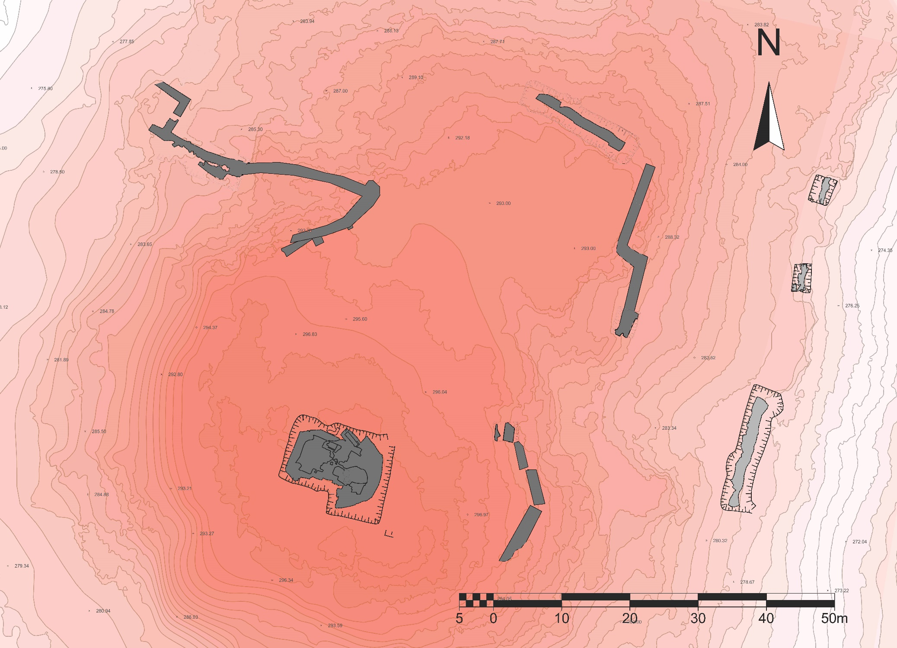
Plan of Khuntsi fortress
After archaeological investigation over ten years, we can suggest that this fortress could be ancient Onogouris, mentioned by Agathias of Myrina, who is among those who described military engagements in west Georgia in AD 541 between Byzantium and its Laz allies on the one side, and the Sassanid Persian Empire on the other. It was part of a confrontation that lasted for more than 20 years, and historical accounts describe it as the ‘Great War of Egrisi’.

Slide 19
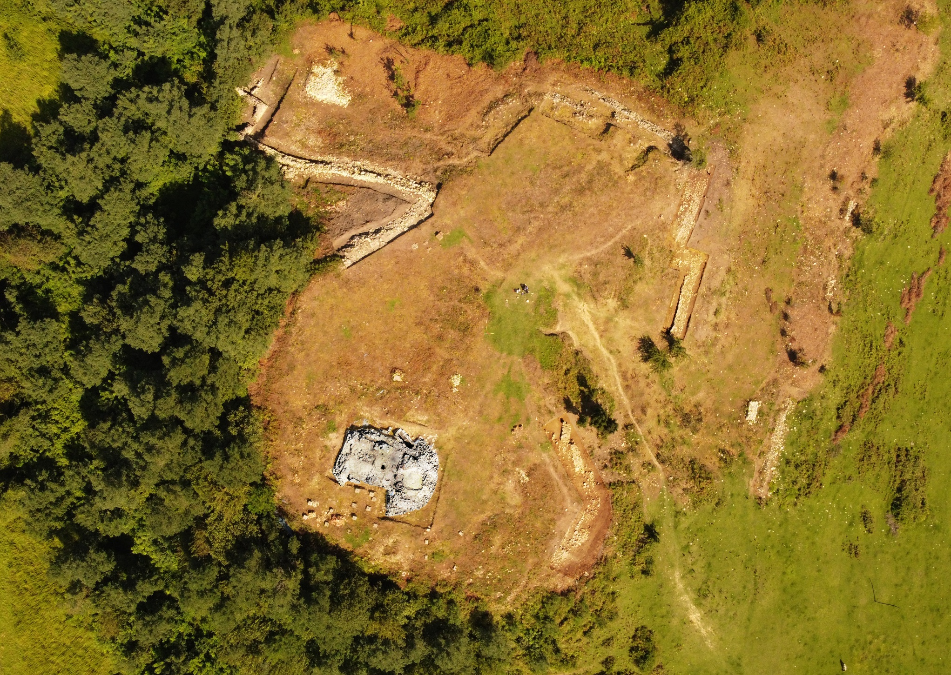
Aerial view of Khuntsi fortress
Agathias refers several times to the fortress of Onoguris, which was strategically important to both the Byzantines and the Iranians. Agathias, Histories, II.22.3:3 “Then, after he had reinforced the Persian garrison at Onoguris (which he had established in the district of Archaeopolis as a hostile base against the Romans) putting new heart into the men and making the place as secure as possible, he returned to Cotaïs and Mucheiresis.”

Slide 20
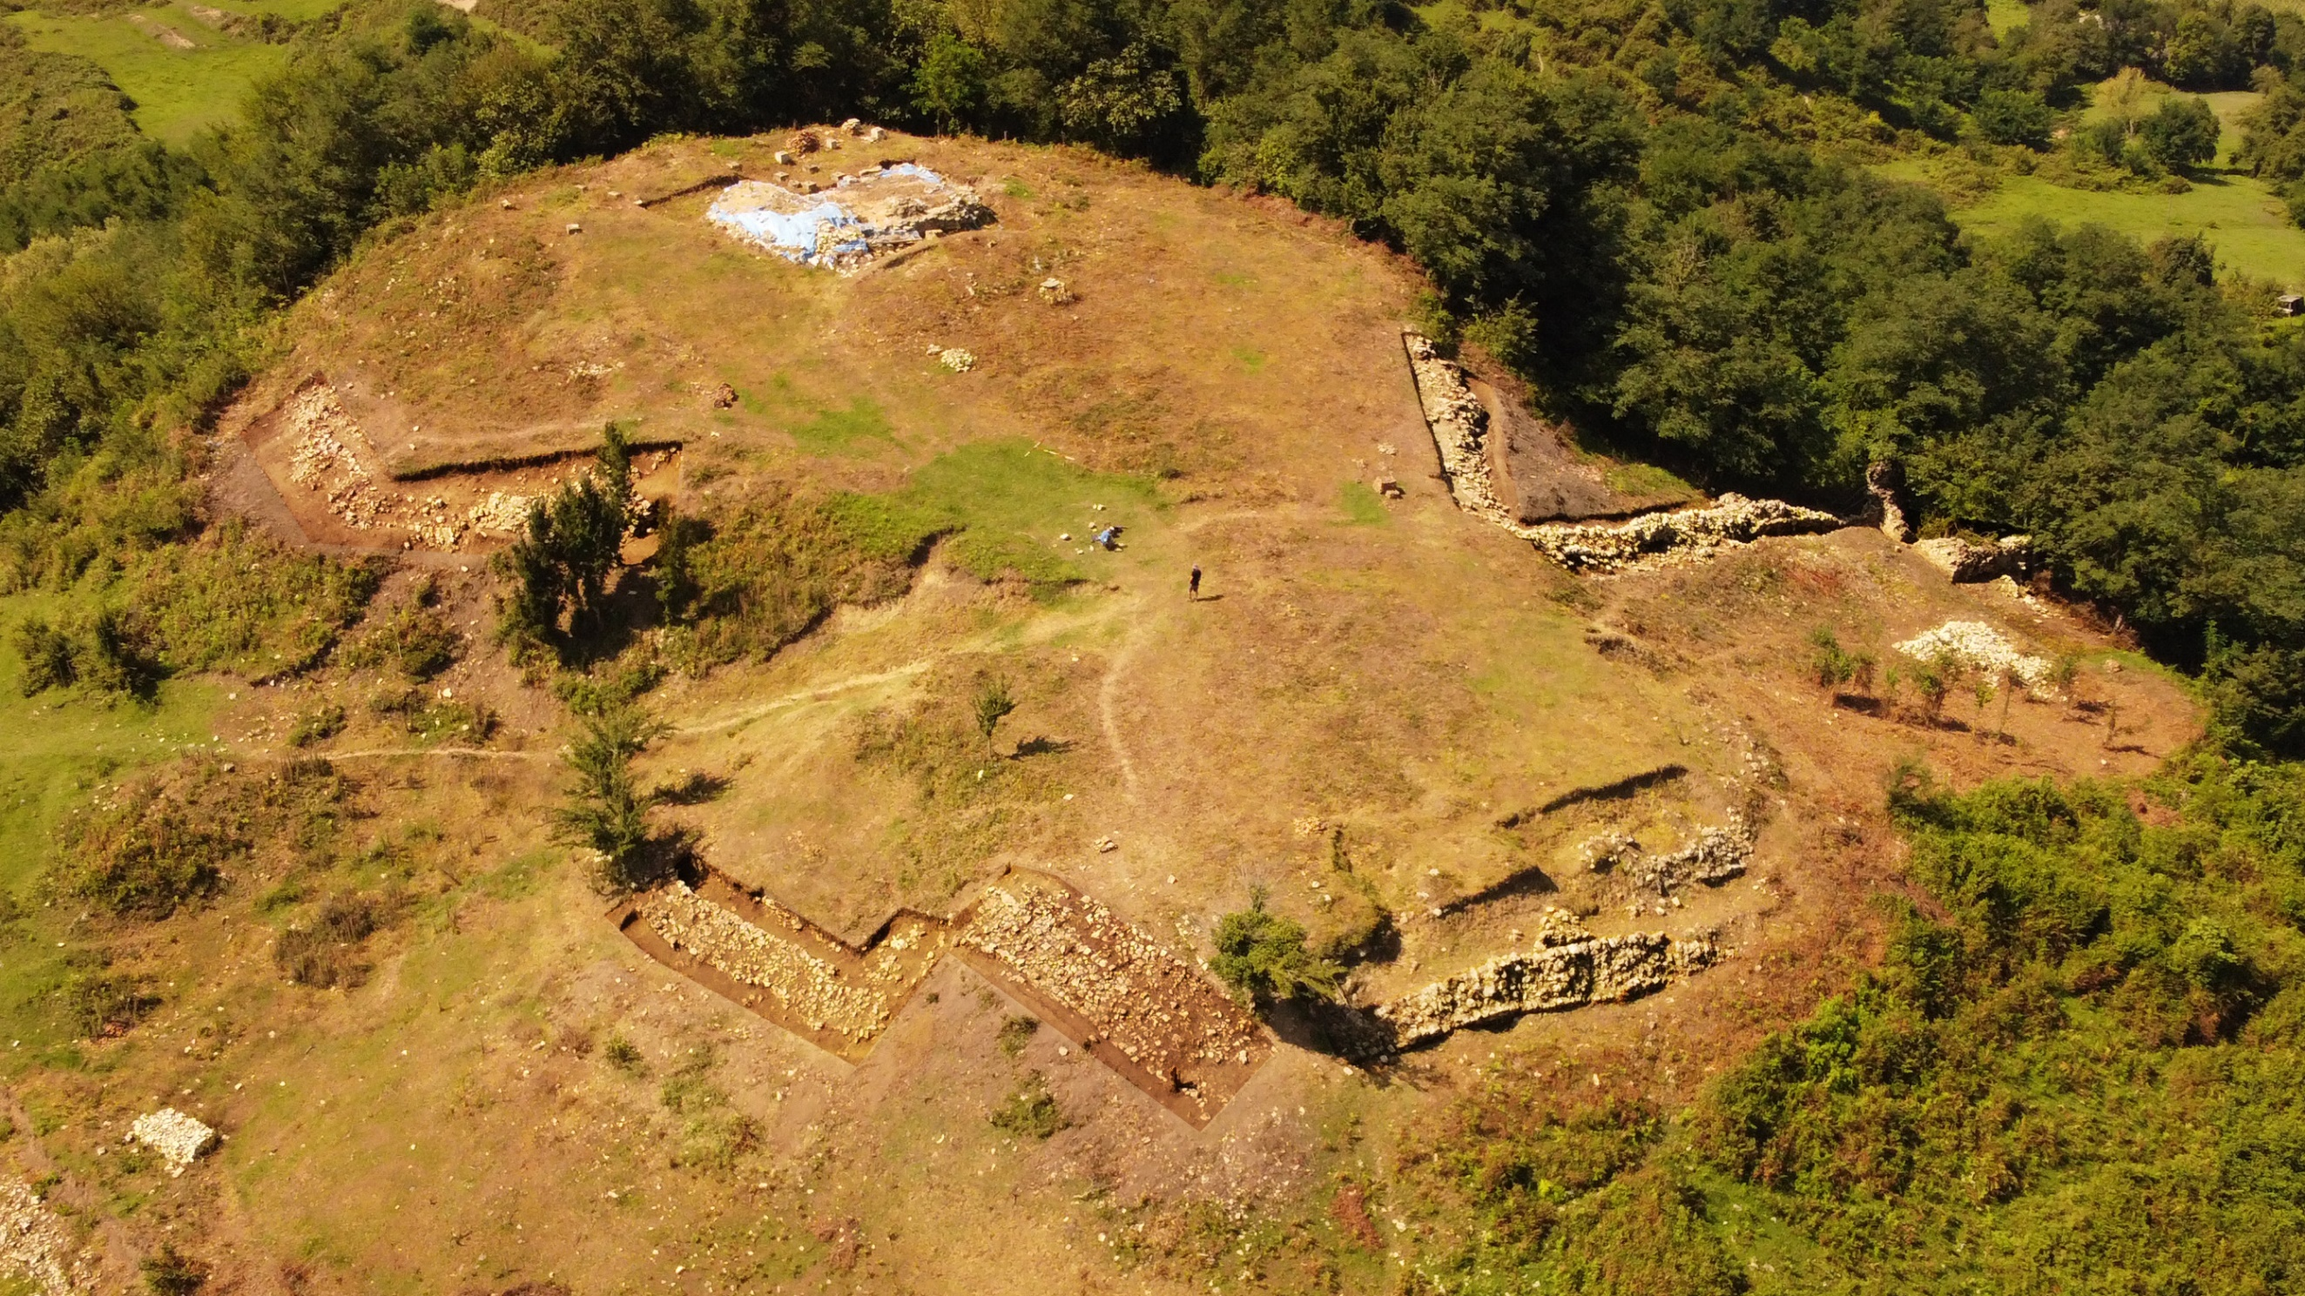
Aerial view of Khuntsi fortress
The expedition has excavated up to 150 meters of the substantial
fortification walls, two towers, and a fragment of gate.

Slide 21
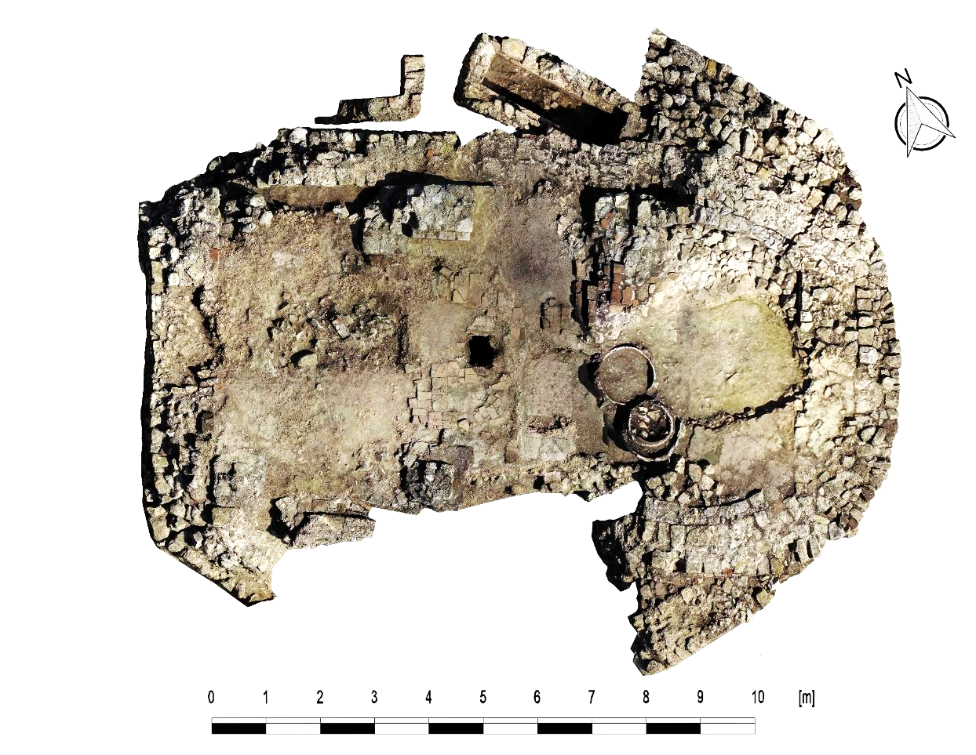
Orthophoto of Khuntsi fortress temple (5th-6th cc AD)
Excavation has also revealed the remains of a temple, with interesting architectural details: including angled corners, rather than square; four column bases in the interior built separately, but just right to the walls; and additional structures, perhaps to support an apse. All of these elements are very unusual for early Christian temples and there is no comparable site in Georgia, the Caucasus or any other Christian region.

Slide 22
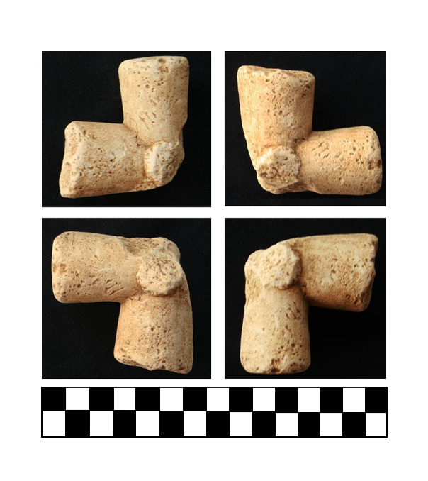
Cross fragment, found on the floor of the temple (5th-6th cc AD)

Slide 23
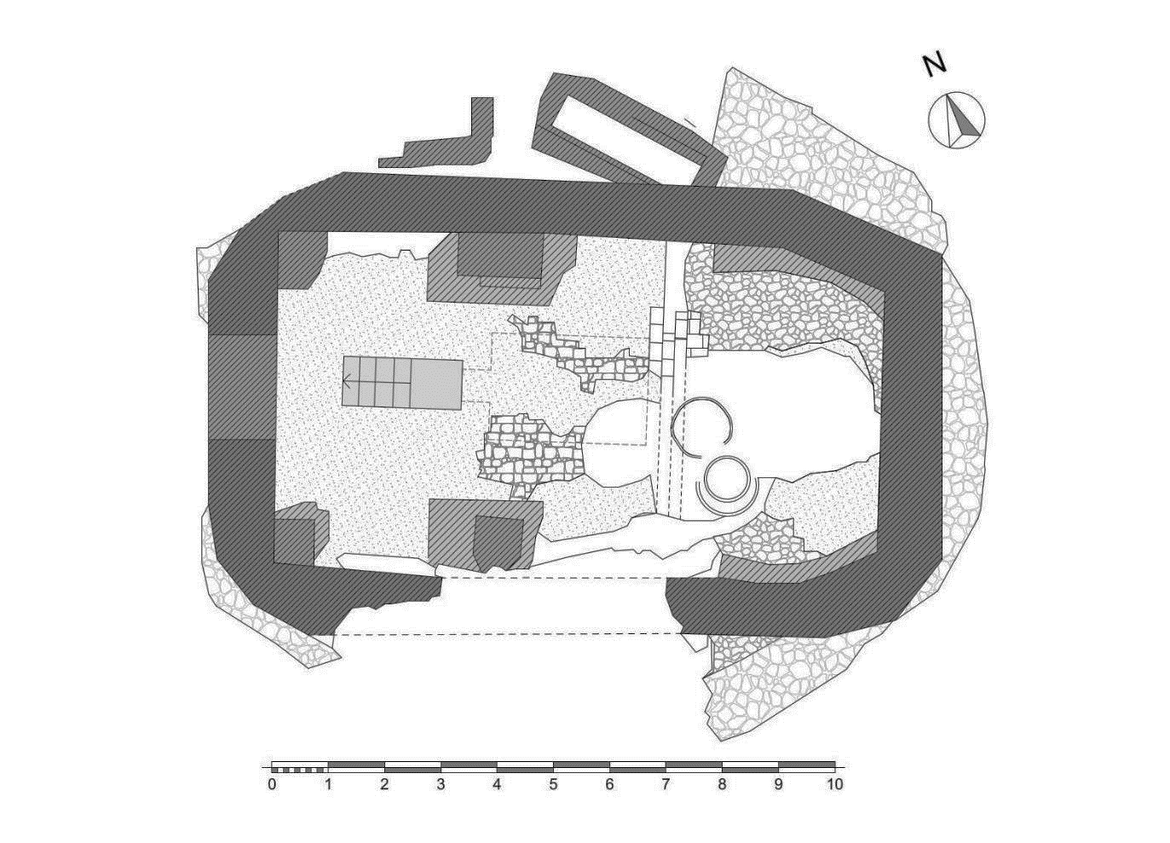
Plan of Khuntsi fortress temple (5th-6th cc AD)
Angled corners, rather than square; four column bases in the interior built separately, but just right to the walls; and additional structures, perhaps to support an apse.

Slide 24
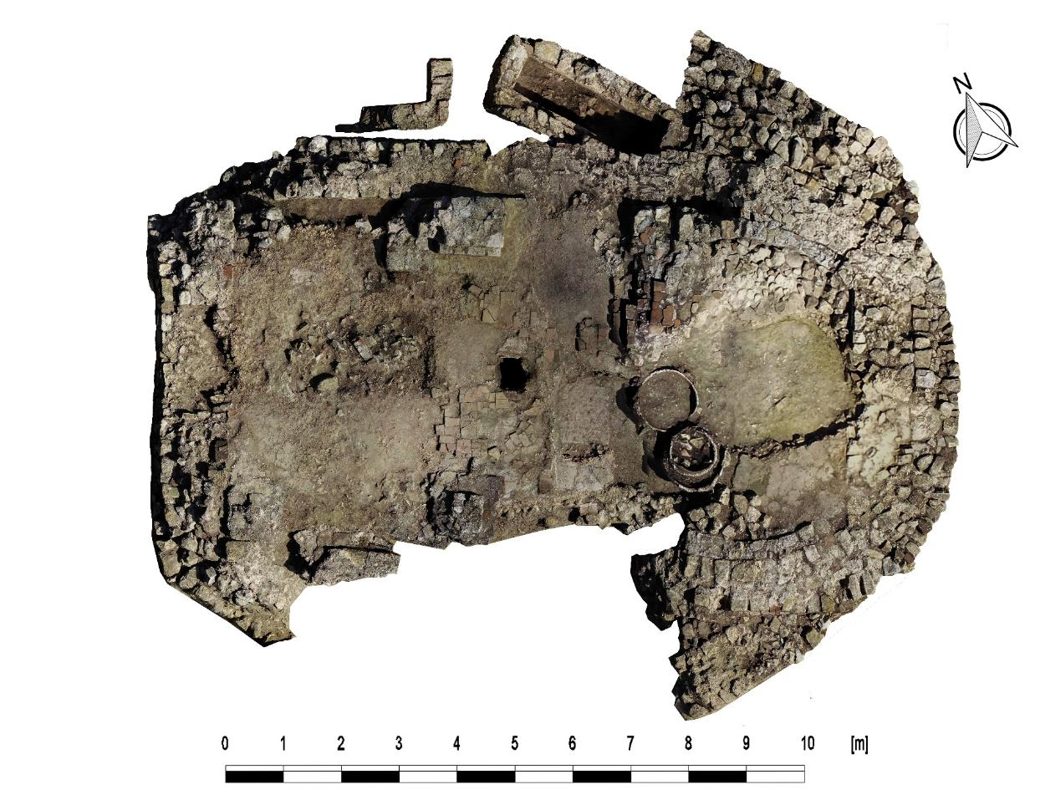
Orthophoto of Khuntsi fortress temple (5th-6th cc AD)

Slide 25
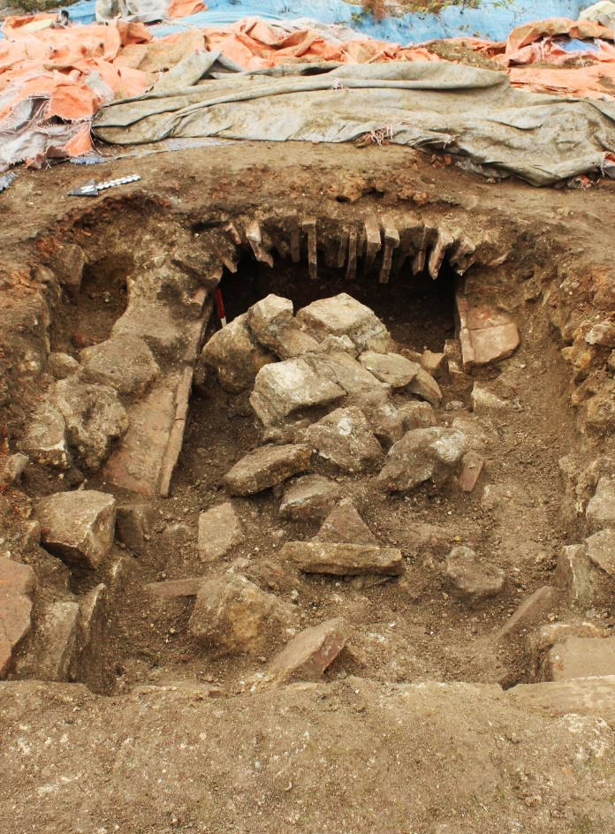
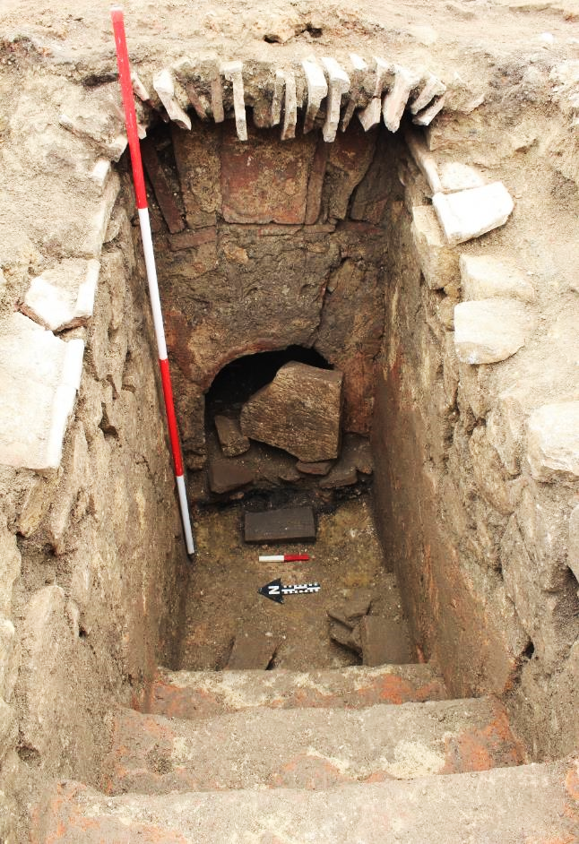
Entrance (Dromos) of the Crypt before and after cleaning. View from East

Slide 26
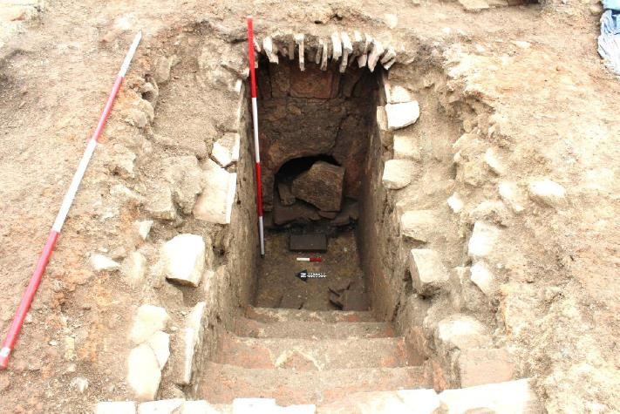
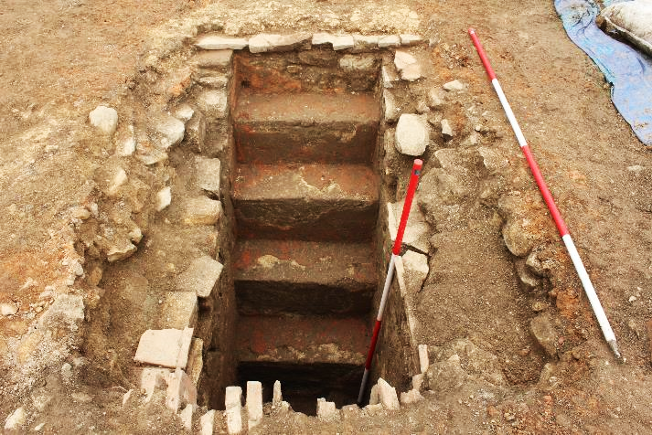
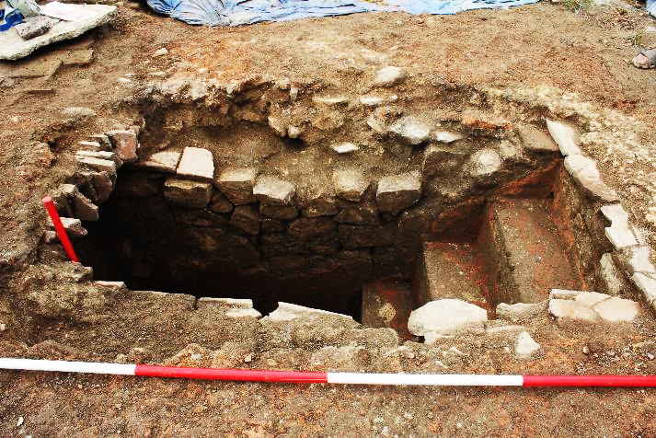
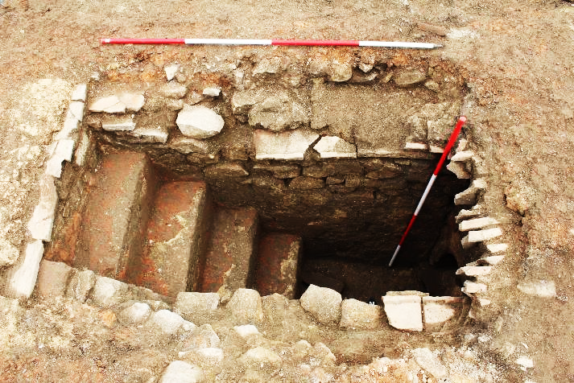
Five step Entrance (Dromos) of the Crypt

Slide 27
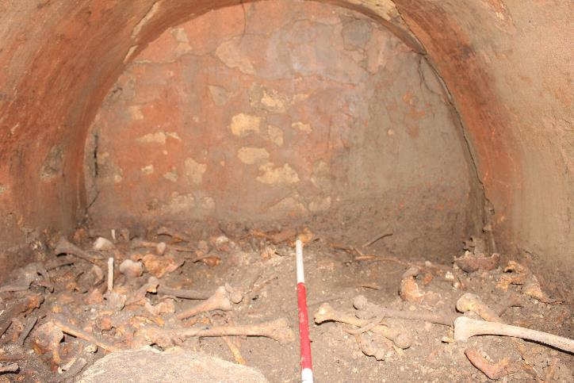
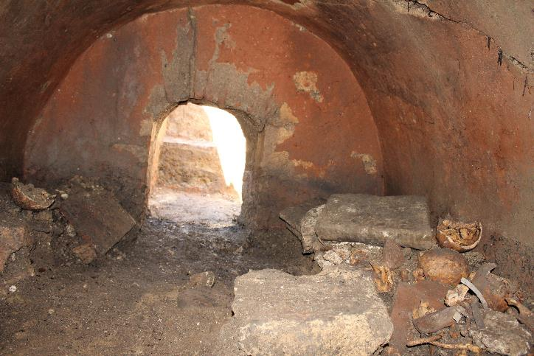
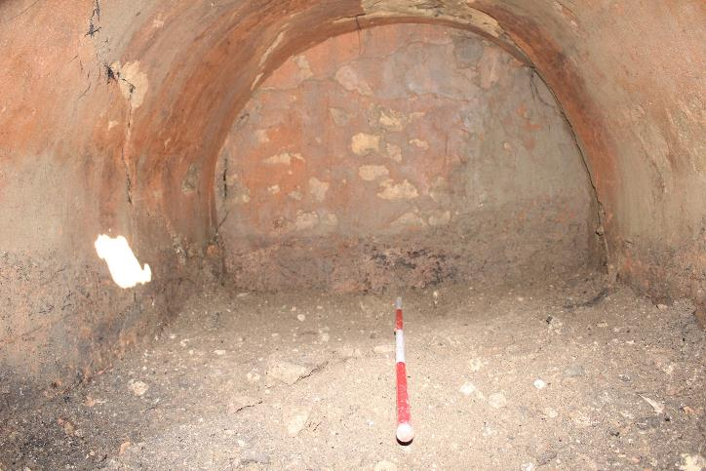
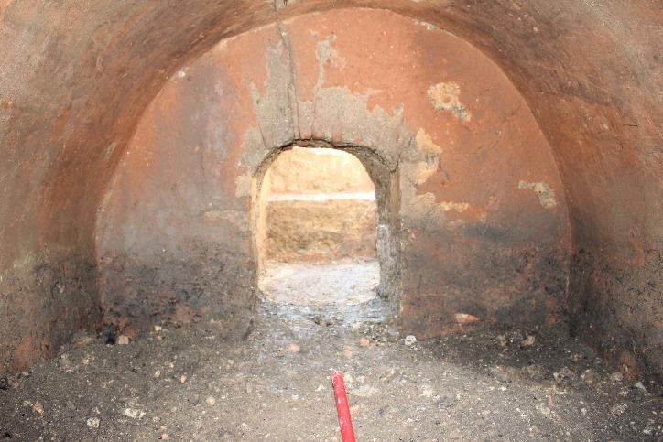
Interior of the Crypt before and after cleaning

Slide 28
Plan of Khuntsi fortress temple (5th-6th cc AD)
Therefore, based on the dating evidence and the fact that Onogouris was occupied by a Sassanid Persian army for several years, we believe that this temple, supported by four columns, was dedicated to another religion (for example Zoroastrianism). Later it was adapted or reconstructed as a Christian church, and this perfectly demonstrates the complex nature of the spread and development of Christianity in West Georgia in the late Roman-early medieval period.

Slide 29
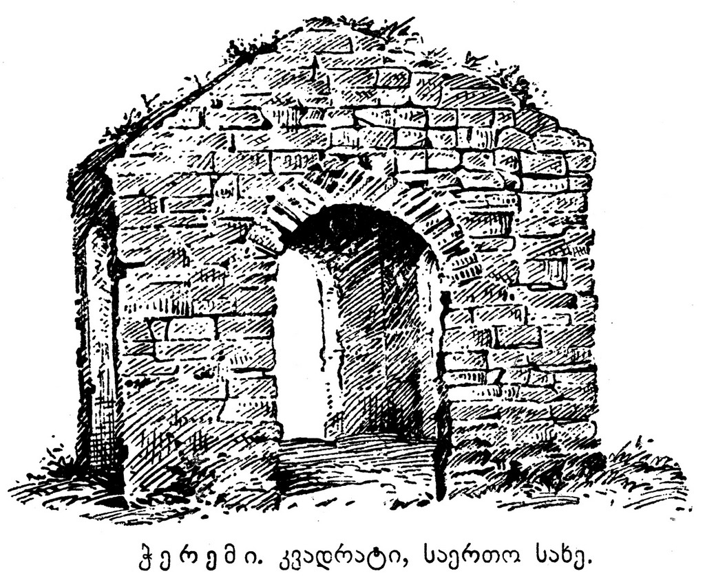
Cheremi temple, East Georgia (4th-5th cc AD)

Slide 30
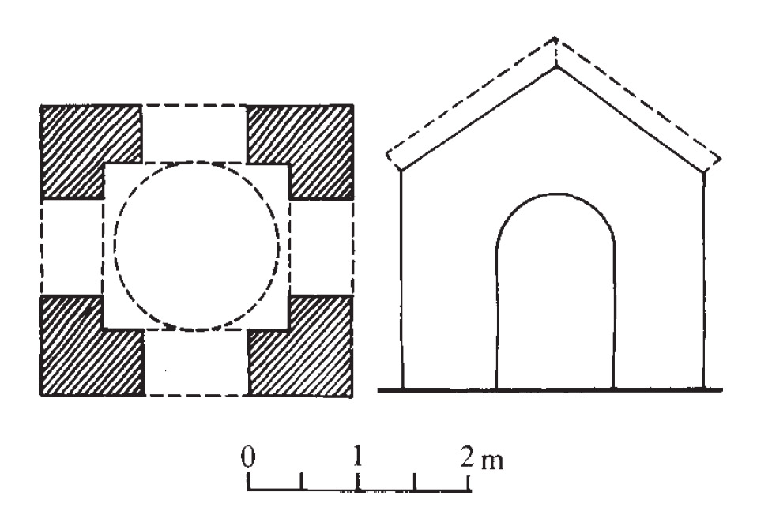
Cheremi temple, East Georgia (4th-5th cc AD)

Slide 31
The Great War of Egrisi – Lazica war (541-562)
The Great War of Egrisi, was fought between the Byzantine Empire and the Sasanian Empire for control of Lazica. The Lazic War lasted for twenty years, from 541 to 562, and ended with the Fifty-Year Peace Treaty, which obligated the Byzantine Empire to pay tribute to Persia each year for the recognition of Lazica as a Byzantine vassal state by Persians.
Lazica, situated on the eastern shore of the Black Sea, and controlling important mountain passes across the Caucasus and to the Caspian Sea, had a key strategic importance for both empires. For Byzantines, it was a barrier against a Persian advance through Iberia to the coasts of the Black Sea. Persians on the other side hoped to gain access to the sea, and control a territory from Iberia, which was by now under their firm domination, could be threatened.

Slide 32
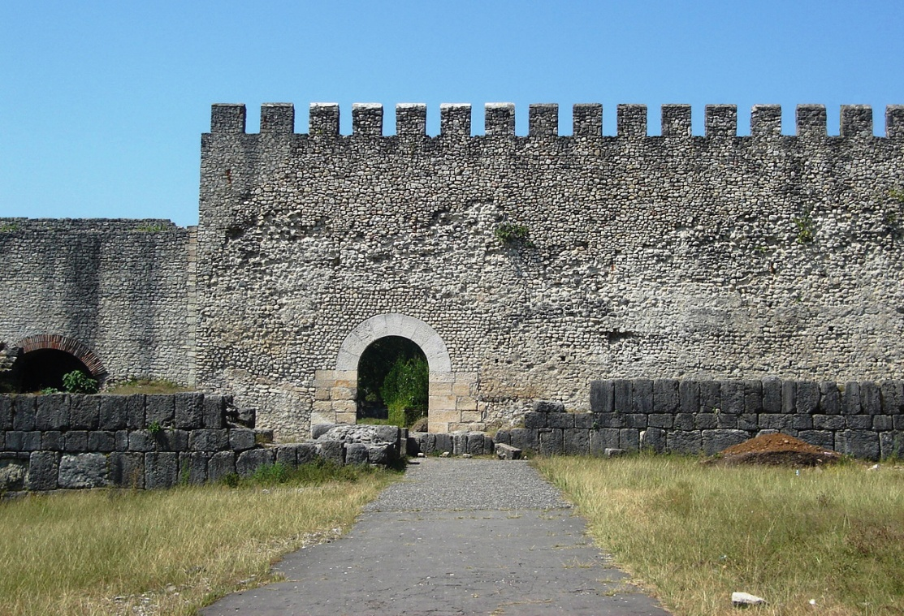
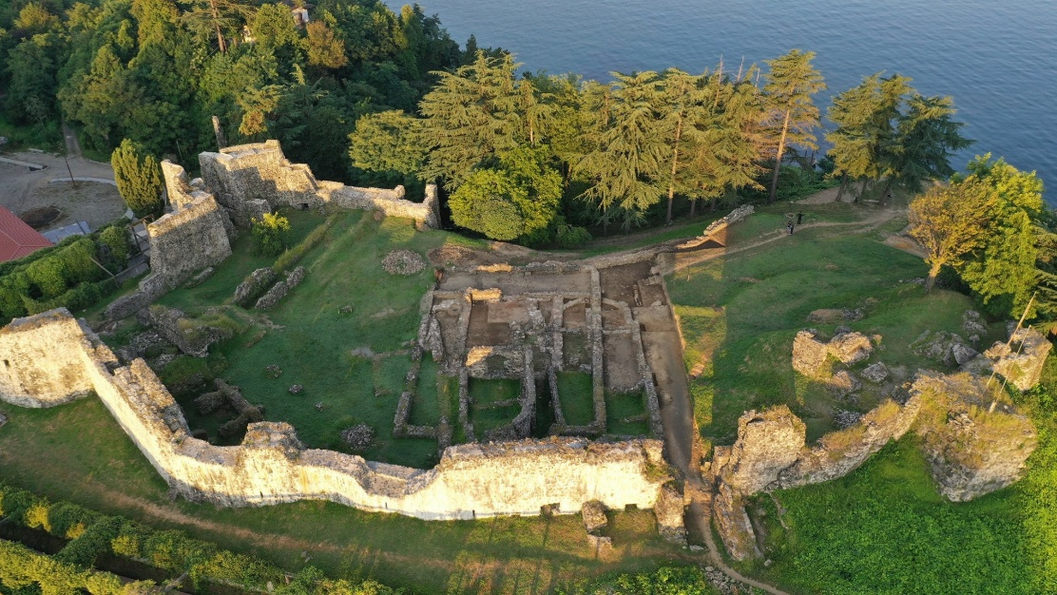
The Great War of Egrisi – Lazica war (541-562)
Lazica featured a difficult terrain and was surrounded by naturally impregnable borders. Besides, it was protected by strong fortresses, including Archaeopolis, Petra, Sarapanis, Skande, Phasis, Rhodopolis, Uchimerion, Kutaisi, Onoguris, Sebastopolis and Pitius.
During the war several principle battles were fought between Laz/Roman and Sassanid troops to take control over the capital city of the kingdom Archaeopolis and main Black Sea coastal cities – Phasis and Petra.
Nokalakevi-Archaeopolis
Petra-Tsikhisdziri

Slide 33
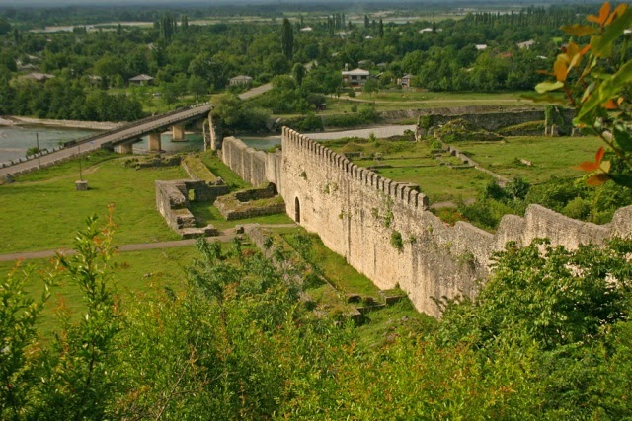


The Siege of Archaeopolis (551)
Nokalakevi-Archaeopolis consists of a lower town and a citadel, set in a loop of the river Tekhuri where it emerges from a gorge in the mountains onto the Colchian plain.
The lower town borders the river to the south and west and a steep slope to the north. Perched on the crest of this ridge sits the citadel with fine views across the plain to the south and east.
Walls connect the two parts of the city. On the east side of the lower town, unprotected by nature, successive rulers built three parallel defensive walls with towers and a strongly fortified gate.
Persians and Sabiri attacked the city walls with warrior elephants, while Archaeopolis was guarded by 3 000 Roman and Lazi garrison.
As a result Sassanid failure to take control over Archaeopolis.
Watercolour by Phil Marter illustrating
a key moment in the Persian attack on Nokalakevi in AD 551

Slide 34







BYZANTINE EMPEROR MAURICE
TIBERIUS (582-602) GOLDEN COINS
FRAGMENT OF THE 4TH-6TH cc AD
STONE-CROSS WITH GREEK INSCRIPTION
AMPHORAE FROM CITADEL. 6TH c. AD

Slide 35






The siege of Petra
The siege of Petra was fought in 550 AD, between the Byzantines (East Romans) under the general Bessas, and the Sasanian Persian garrison of Petra in the buffer state of Lazica.
After a failed attempt to recapture Petra in 549, the Byzantine emperor Justinian I sent an army under Bessas to retake the fortress. The Byzantine historian Procopius described the resulting siege in vivid detail.
500 Sasanian forces who had shut themselves in the acropolis refused to surrender, in spite of an offer of capitulation, preferring instead a heroic death.
6th century Persian coins, chain-armour, helmet and other military weapons discovered in the acropolis of the Petra-Tsikhisdziri in 2017

Slide 36

The fall of Lazica Kingdom
At the end of the 6th century, after the great war in Lazica, the Byzantines abolished the monarchy in Egrisi. The country was ruled by an appointed official, Patrician, who had to be a noble from Egrisi. This situation lasted until the end of the 7th century.
At the end of the 7th century, Patrician Sergius of Egrisi, who was upset with the Byzantines, handed over the country to the Arabs. However, the Egrisi people soon rebelled against the Arabs. To suppress the rebellion, in 735-737, the Arab general Marwan ibn Muhammad, also known as Marwan the Deaf, led a campaign to Georgia. Marwan the Deaf captured and destroyed the capital of Egrisi, Tsikhegoji-Archaeopolis.
Essentially, from this time, Egrisi ceased to exist as a state, and by the end of the 8th century, a new Georgian state — the Kingdom of Abkhazia — was formed in western Georgia.

Slide 37

THANK YOU FOR YOUR ATTENTION
Dr Nikoloz Murgulia
nikomurgulia@yahoo.com

